Slide 1
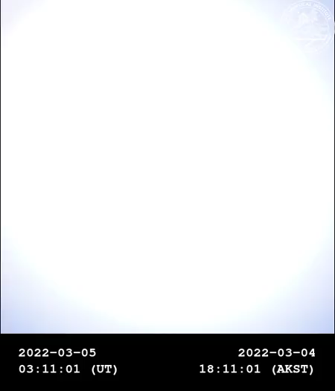
Determining Size of a Precipitation Event with AARDDVARK system of VLF radio wave receivers
VERSIM Conference Jodie McLennan, Allison Jaynes, Mark Clilverd, Craig Roger
October 3rd, 2024 jodie-mclennan@uiowa.edu

Slide 2
Pulsating aurora is important to understand energy flow between M-I
Pulsating aurora is a diffuse like aurora that “blinks” on and off in patches with a variable size and frequency [Partamies+ 2019]
They are caused by magnetospheric waves that pitch angle scatter electrons magnetically trapped in the outer radiation belt region [Kasahara+ 2018]
They typically have higher energies (~100keV), are more common and last longer than other types of aurora [Partamies+ 2019, Sandahl+ 1980]

Slide 3
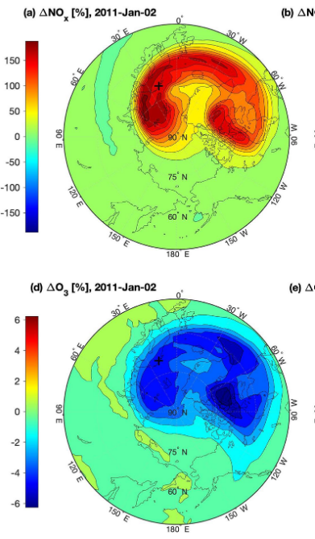
Pulsating aurora has an influence on ozone loss
Can produce NOx and HOx molecules, which get convected to lower altitudes and deplete ozone [Turunen+ 2016, Verronen+, 2021].
Figure below from Verronen+ 2021 showing the increase in NOx and resulting decrease in ozone during a modeled pulsating aurora event
We want to be able to better estimate the energy deposition of pulsating aurora to be able to understand it’s effect on our climate

Slide 4
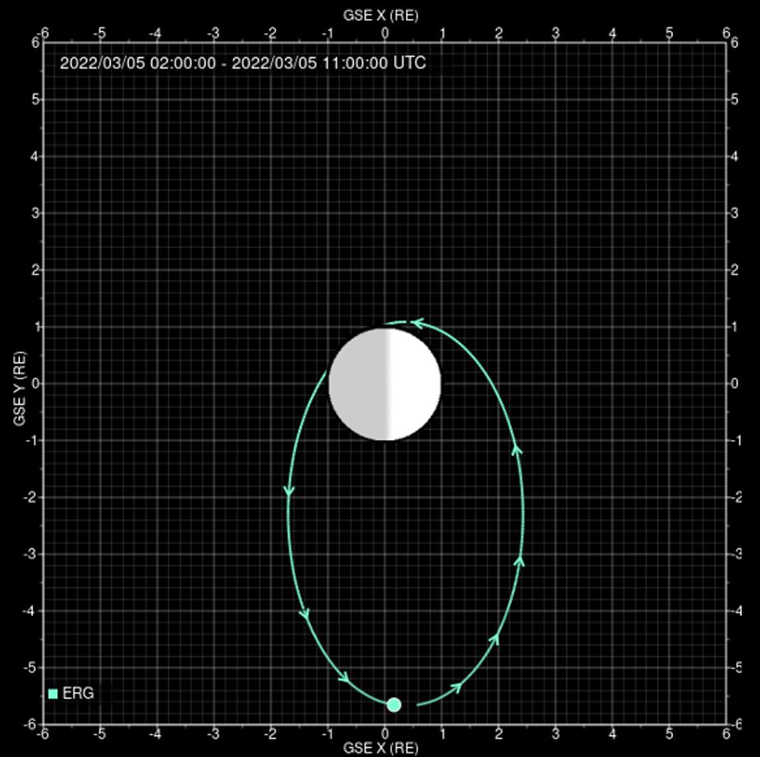
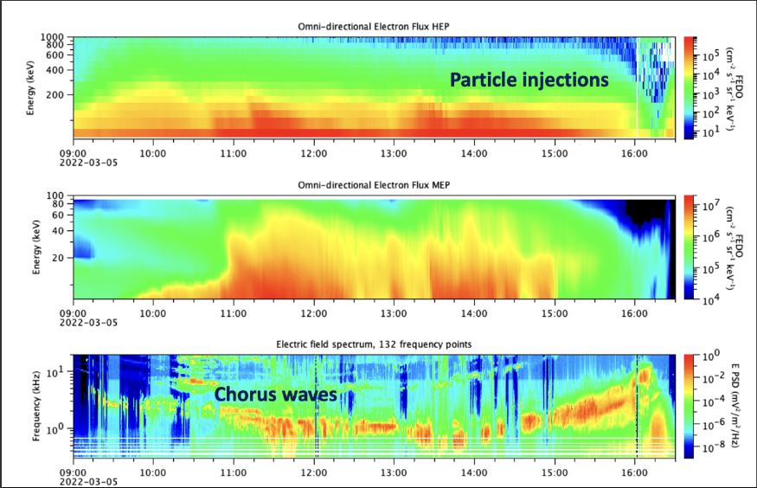
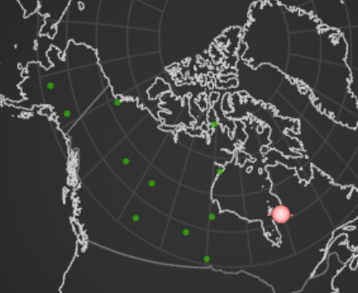
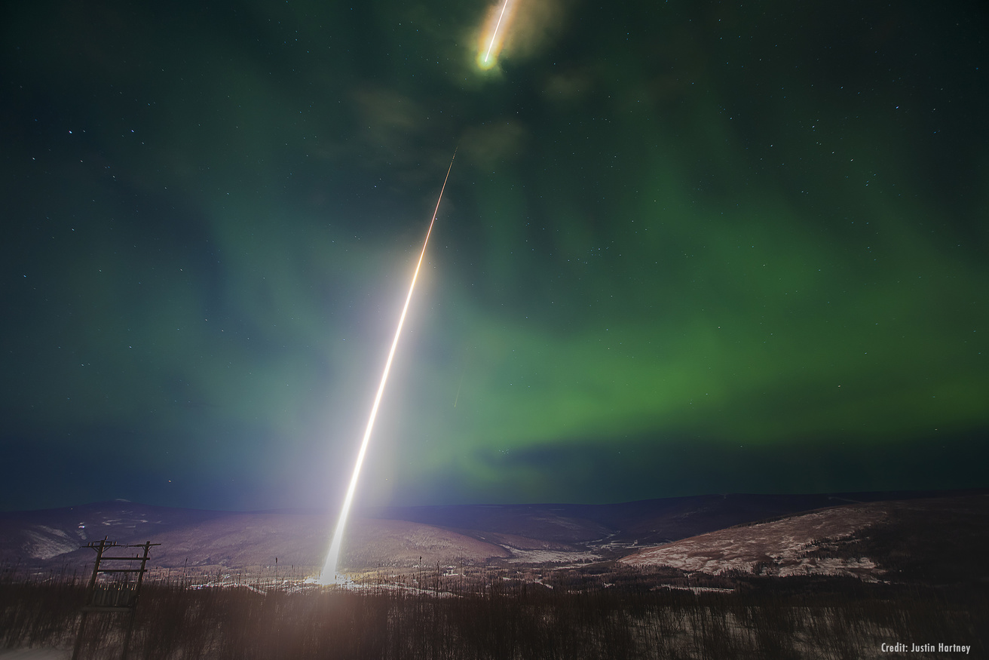
Pulsating aurora during the night of March 5th 2022
The Arase satellite saw high energy particle injections concurrent with increase in pulsating aurora activity
Footpoint at 11:05
Aurorax event explorer
Credit: Jaynes
Image credit: Justin Hartney

Slide 5
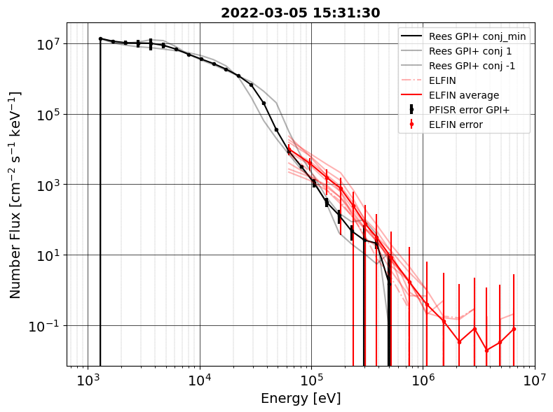
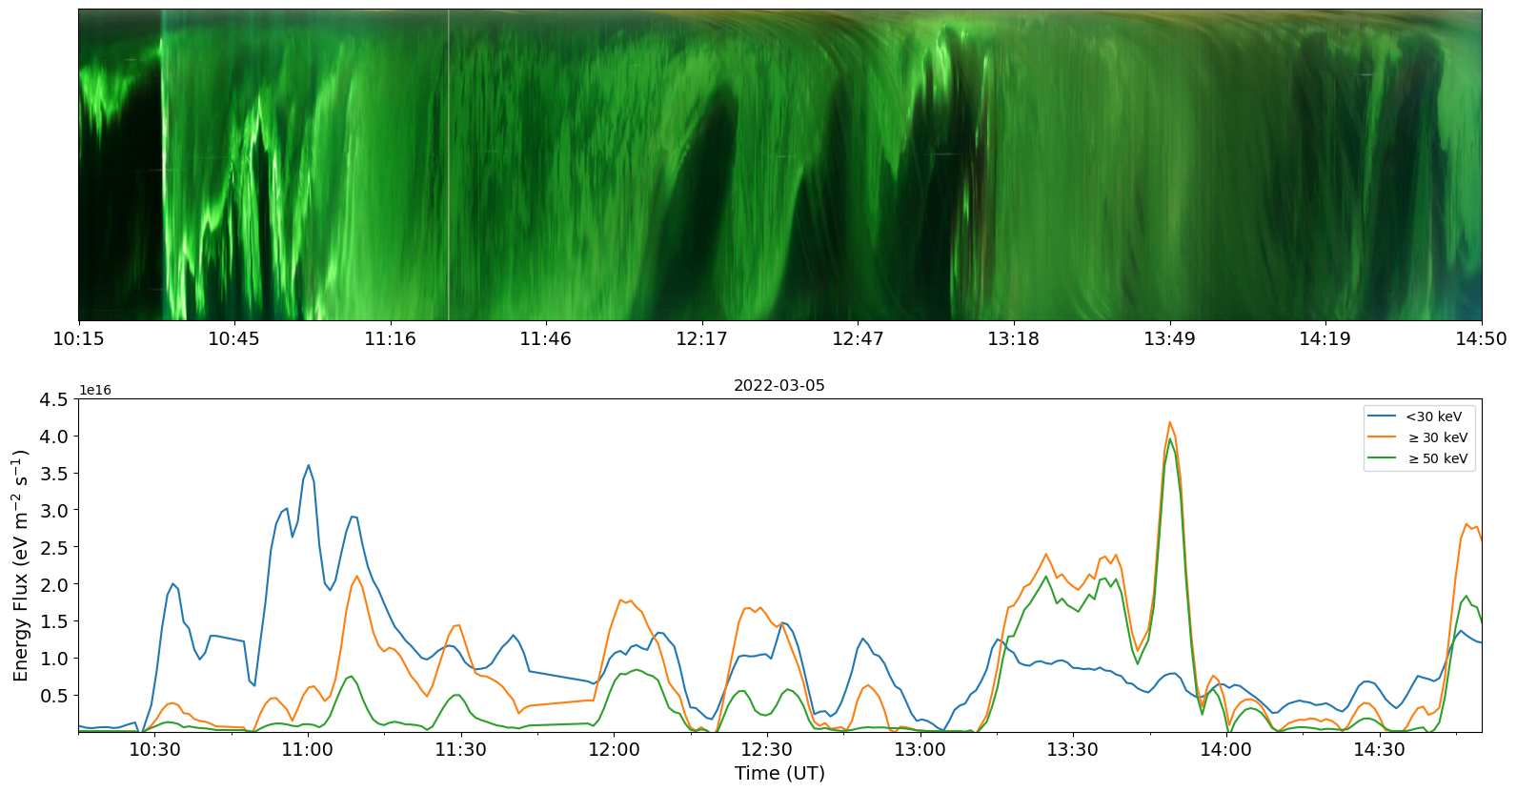
With ISR data we can calculate energy flux at one point
We use an inversion method [Semeter and Kamalabadi, 2005] that calculates the precipitating number flux from electron density over altitude measurements
We use the Poker Flat Incoherent Scatter Radar (PFISR) to find the energy flux – verified by ELFIN data

Slide 6
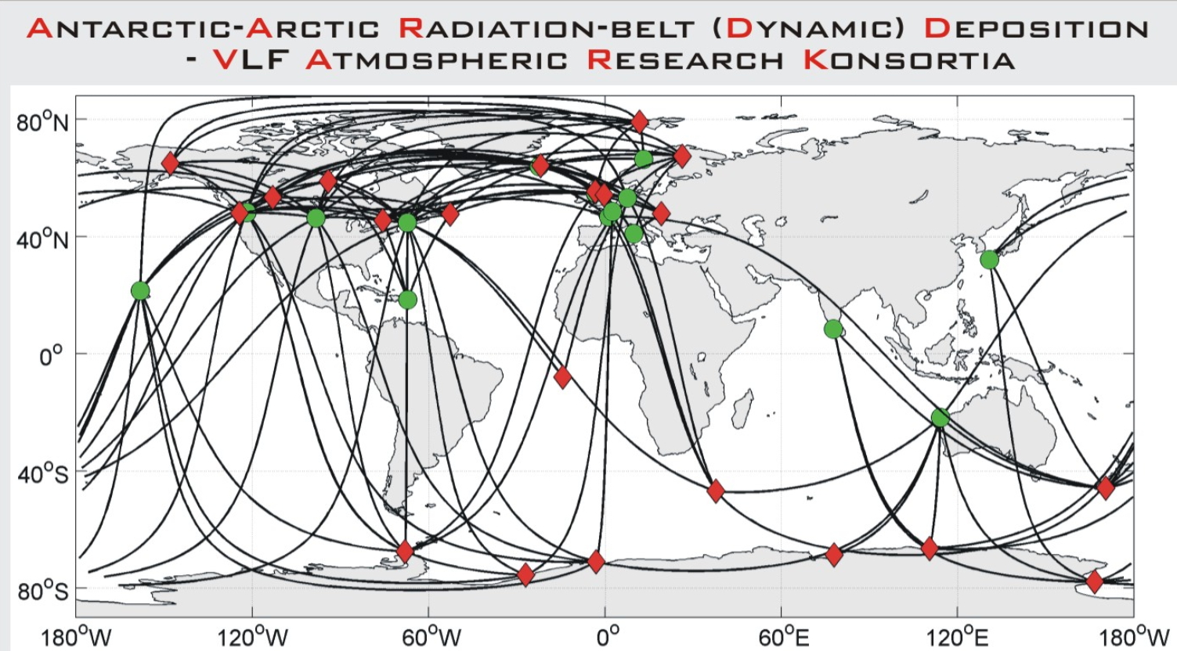
AARDDVARK is a global network of VLF receivers and transmitters
Perturbations can occur in VLF amplitude and phase during events of high energy precipitation, solar proton events, lighting, and x-rays to name a few [Clilverd+, 2009]
The change in effective reflection height of the ionosphere can cause these perturbations [Palit+, 2018]
Since pulsating aurora typically has high energy precipitation (~100 keV) and associated microbursts (relativistic energies), it can cause these perturbations
Image: University of Otago website
Notes:
The competitive role played by the modulation of ionospheric effective reflection height and the inherent process of absorption due to change in electron density level is responsible for such variation. - Palit

Slide 7
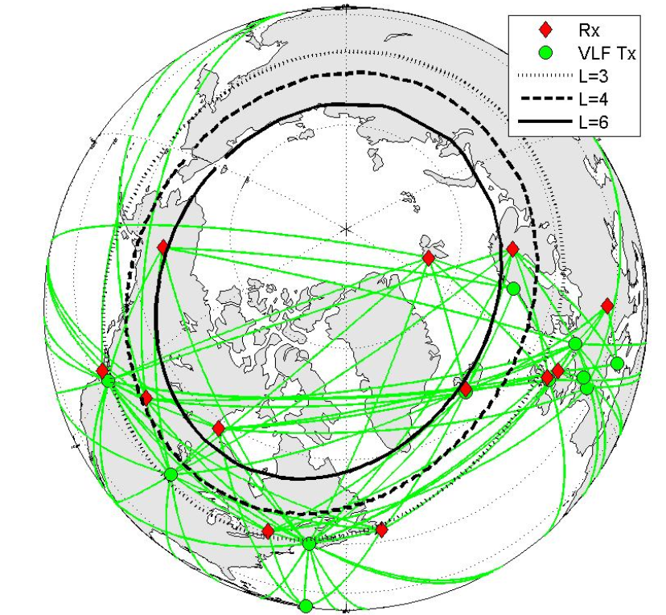
Several AARDDVARK paths overlap the pulsating aurora region
Several paths connected to the Fairbanks and Edmonton receivers cris-cross the observed pulsating aurora region
We use the following transmitters:
NLK – Seattle, USA
NDK – North Dakota, USA
NAA – Maine, USA
NRK – Iceland
Fairbanks
NLK
Edmonton
NRK
NDK
NAA
Image: University of Otago website

Slide 8
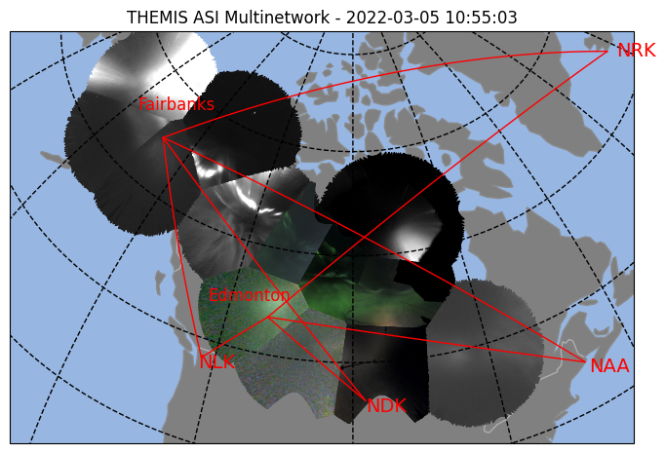
Piecing all our data sources together
PFISR – Precipitating Energy Flux with time
Fairbanks
THEMIS ASIs – When we see pulsating aurora
AARDDVARK VLF Network - when and where precipitation occurs
NLK
Edmonton
NRK
Arase – Timing of substorm injections
NDK
NAA
Image: University of Otago website

Slide 9
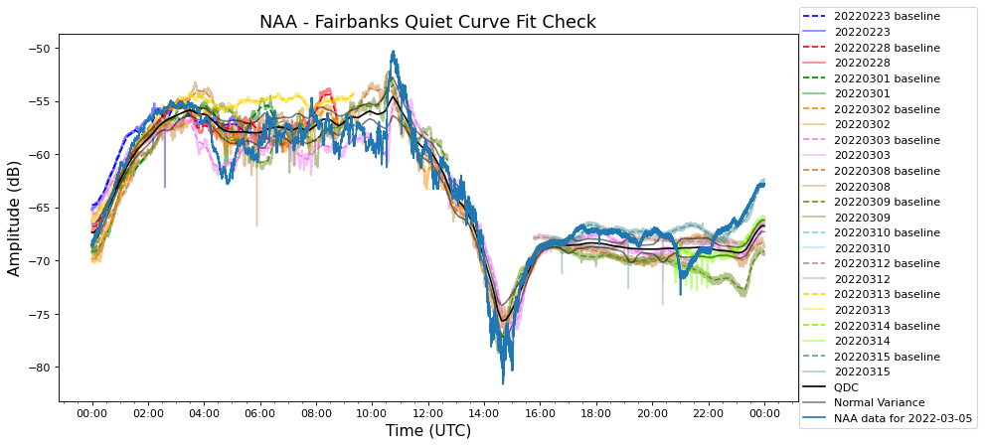
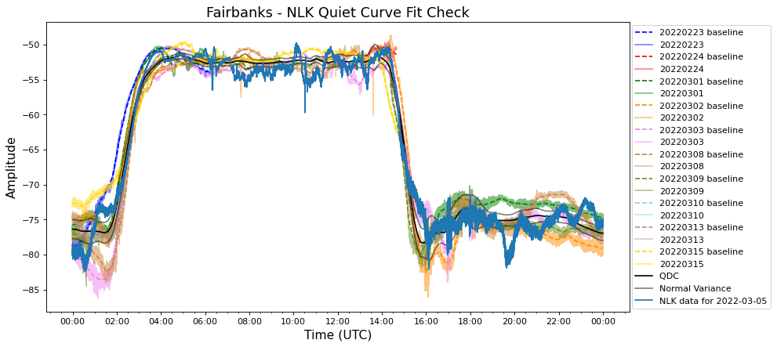
First we need to find a baseline amplitude (QDC)
(dB)
We want to find what amplitude curve should look like without influences of precipitation, this is the baseline or quiet day curve (QDC)
We complied a list of times when there was minimal geomagnetic activity that showed in the magnetometers over path locations
Computed a running average over all the designated quiet times and further adjusted the quiet day curves to best match the event data

Slide 10
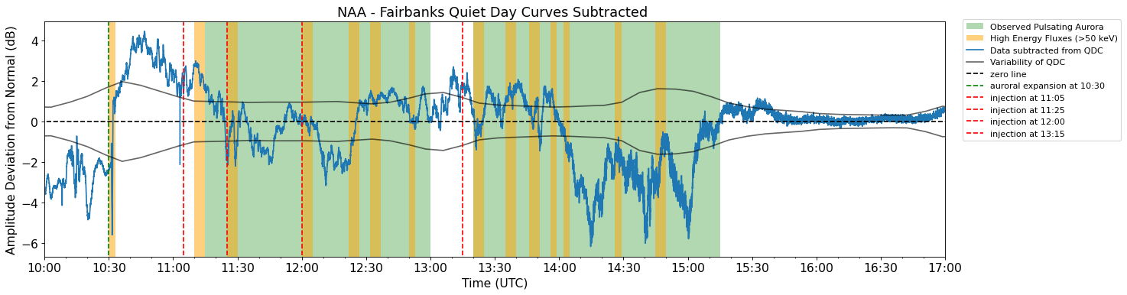
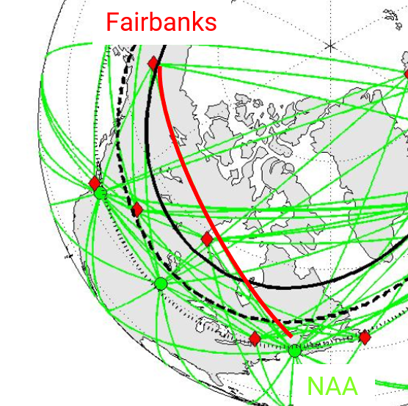
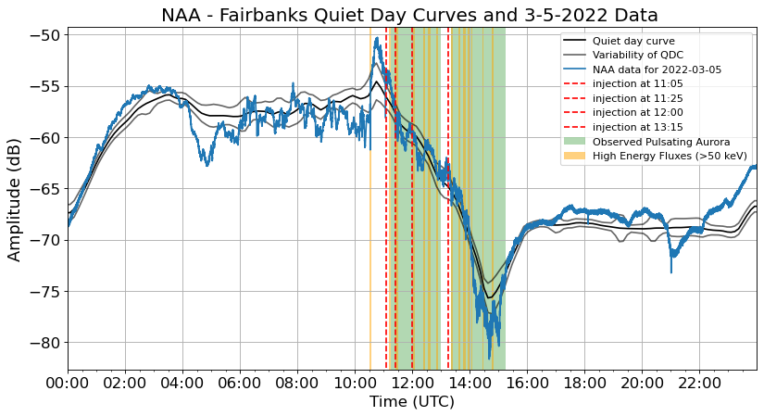
To see the perturbations more clearly, we subtract off the QDC
The arrows are suspected perturbations pointed out during the time of pulsating aurora event
Perturbation = deviation from the QDC that is outside of the normal variability
The zero line and the variability of the QDC serve to help guide your eye to see what is an event

Slide 11
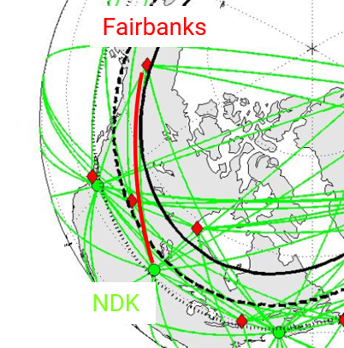
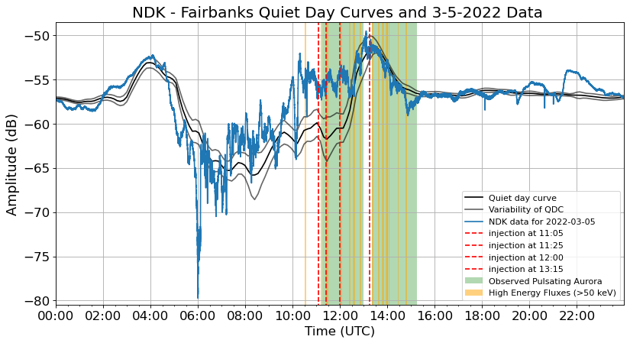
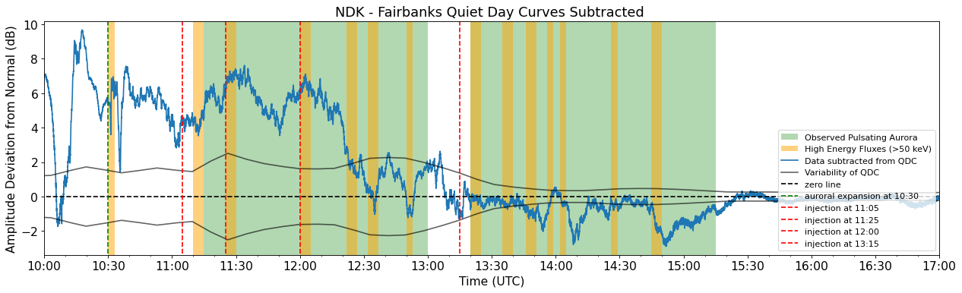
To see the perturbations more clearly, we subtract off the QDC

Slide 12
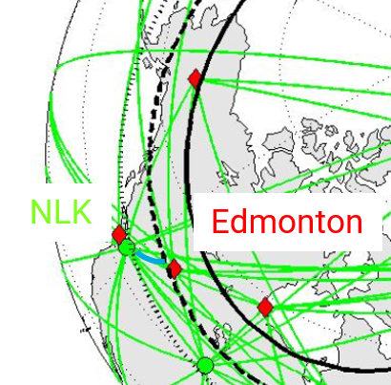
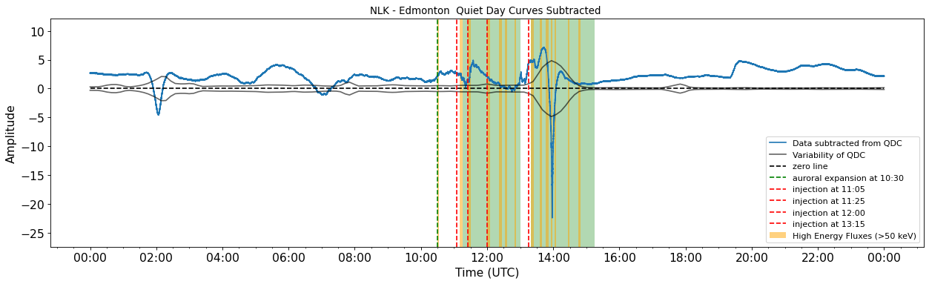
Some paths have less perturbations
On this NLK – Edmonton path there are fewer perturbations
This path is at a lower latitude and shorter – fewer chances for high energy precipitation to occur here
(dB)

Slide 13
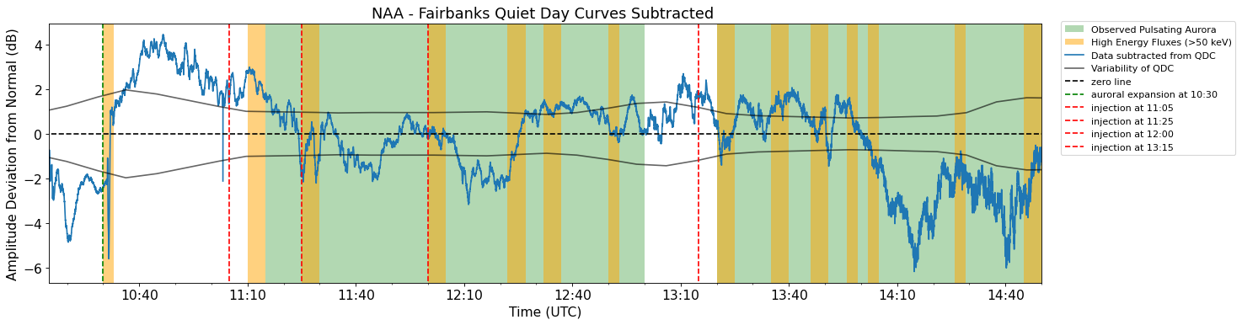
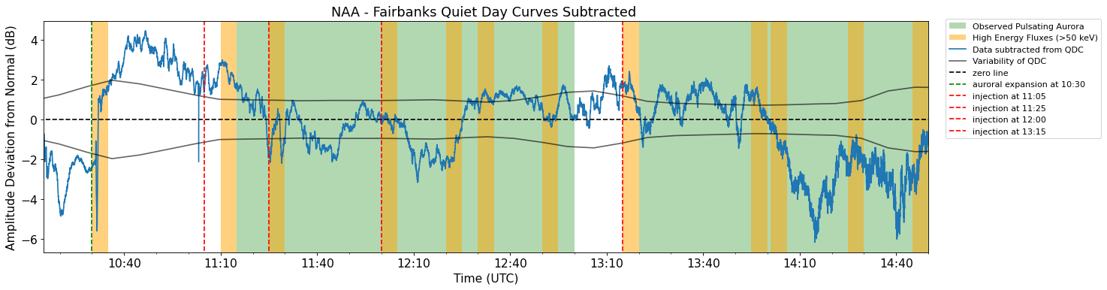
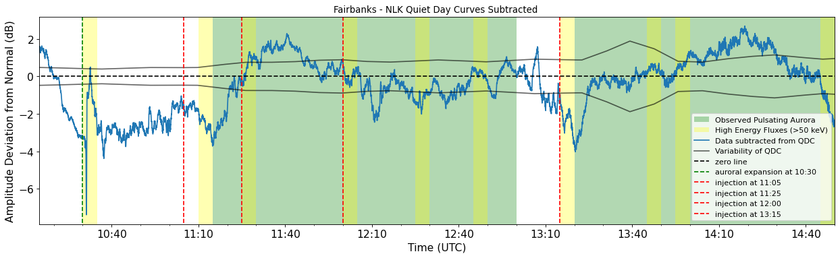
We see perturbations associated with injections and precipitating high energy fluxes
Pulsating aurora
Pulsating aurora

Slide 14
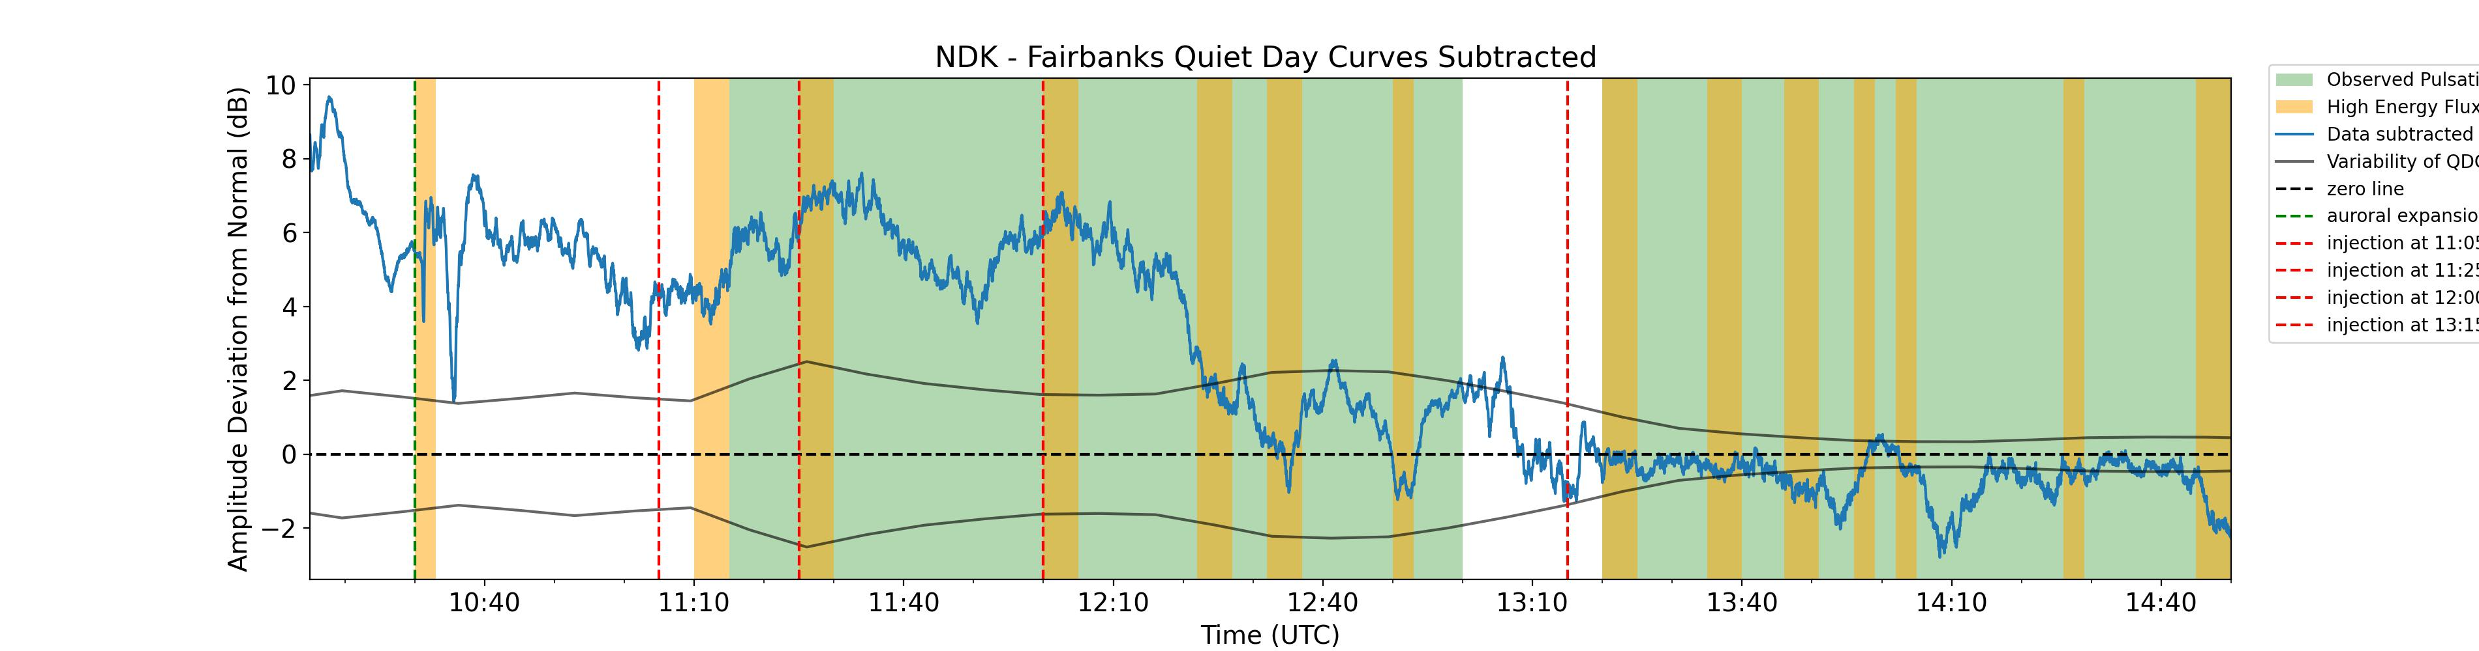
We see perturbations associated with injections and precipitating high energy fluxes

Slide 15
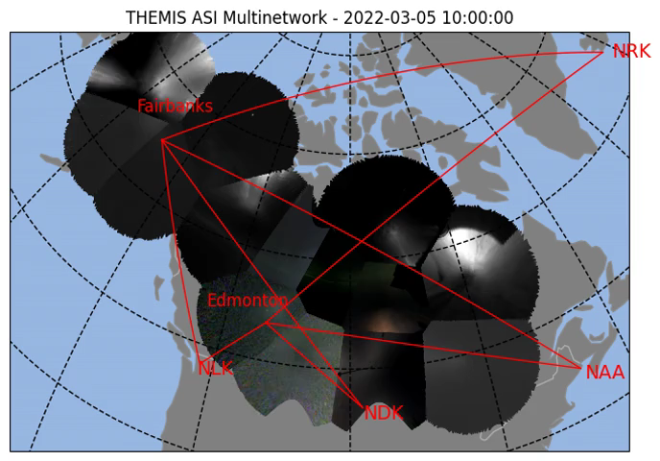
Mosaic movie of the pulsating aurora and path perturbations
Red path = no observed perturbation, Green path = perturbation observed (peak)

Slide 16
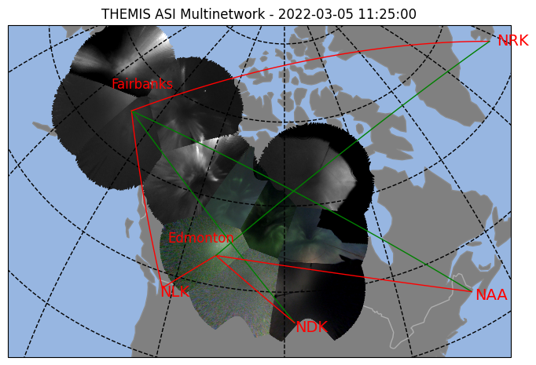
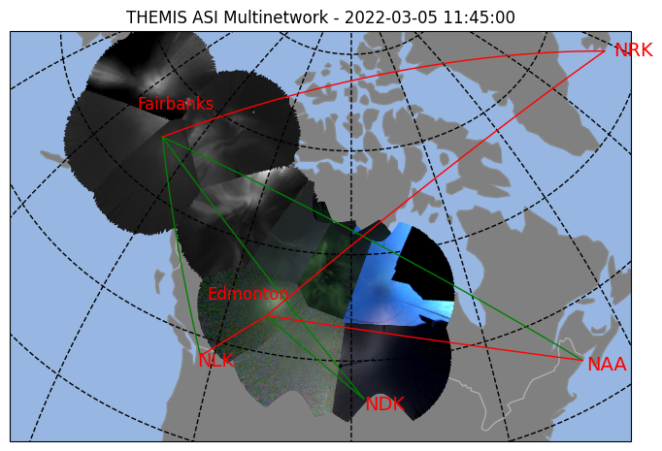
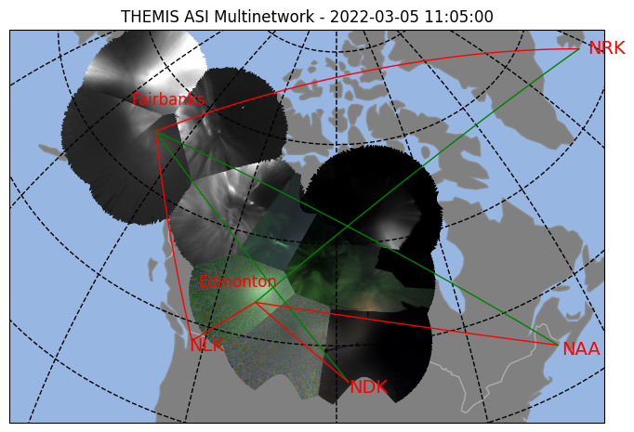


Some representative time stamps
NAA
–
Fairbanks
NDK
–
Fairbanks

Slide 17
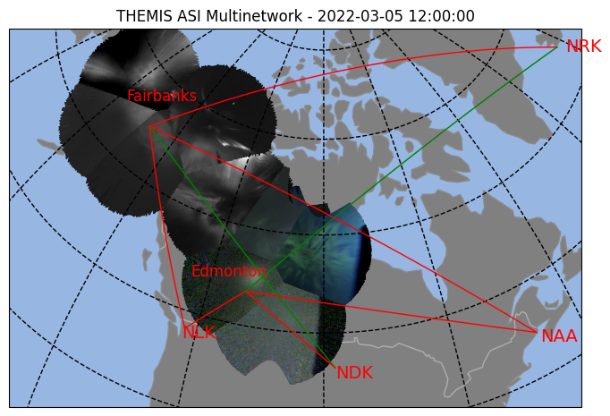
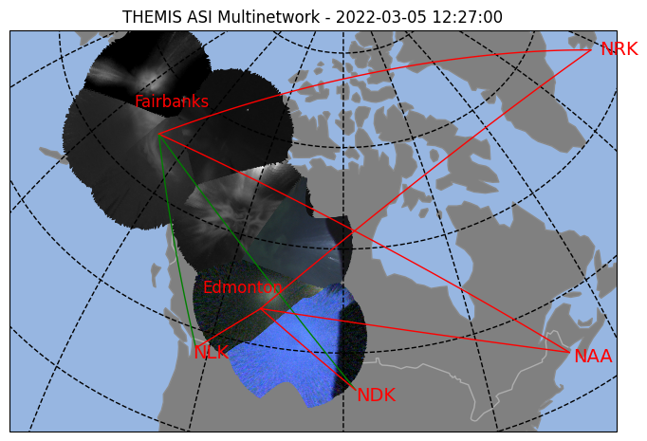
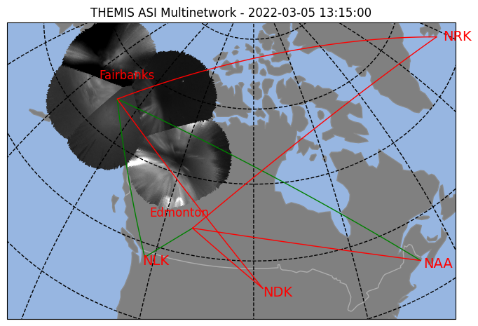
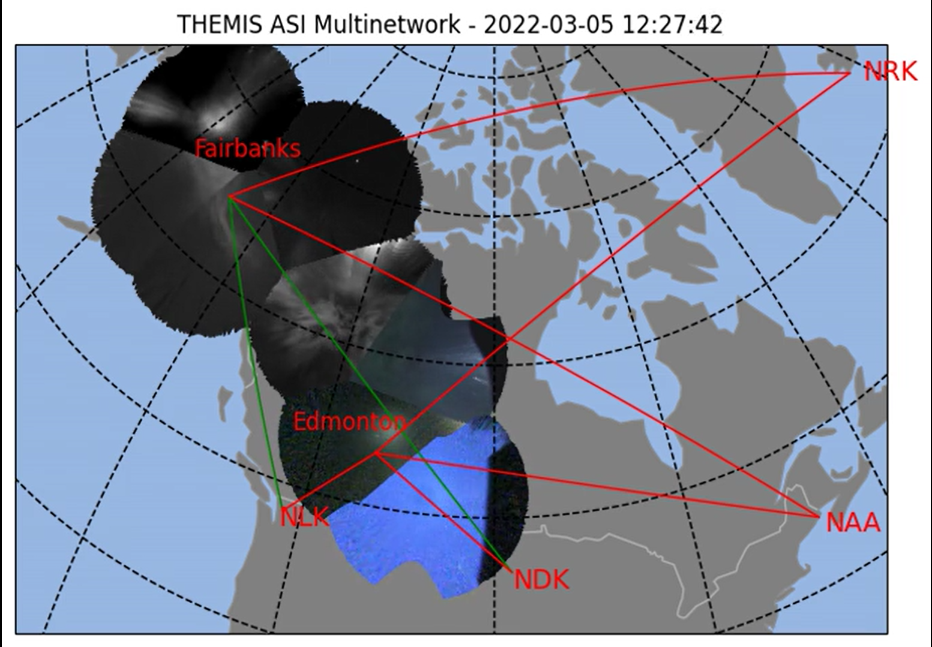
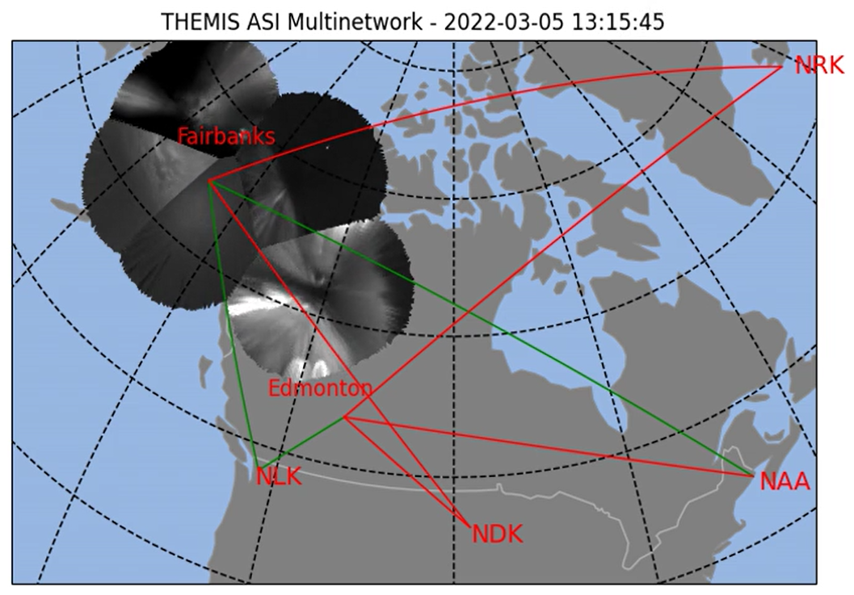
NAA
–
Fairbanks
NDK
–
Fairbanks

Slide 18
Summary and Future work
Showed here:
We can see VLF amplitude perturbations associated with injections and high energy precipitating flux
Next up:
Calculate the upper and lower bounds of the area for this pulsating aurora patch
We can estimate total energy flux with our energy flux at one point and the estimation of the area
Include phase data to my analysis
Questions and comments?

Slide 19
References
Clilverd+ 2009; Remote sensing space weather events: Antarctic‐Arctic radiation‐belt (dynamic) deposition‐VLF atmospheric research Konsortium network.; 10.1029/2008SW000412
Kasahara+ 2018; Pulsating aurora from electron scattering by chorus waves; 10.1038/nature25505
Palit+ 2018; Response of Earth's Upper Atmosphere and VLF Propagation to Celestial X‐Ray Ionization: Investigation With Monte Carlo Simulation and Long Wave Propagation Capability code; 10.1029/2018JA025992
Partamies+ 2017; Occurrence and average behavior of pulsating aurora; 10.1002/2017JA024039
Partamies+ 2019; Patch Size Evolution During Pulsating Aurora; 10.1029/2018JA026423
Sandahl+ 1980; Rocket observations of precipitating electrons over a pulsating aurora; 10.1029/GL007i005p00309
Turunen+ 2016; Mesospheric ozone destruction by high‐energy electron precipitation associated with pulsating aurora; 10.1002/2016JD025015
Verronen+ 2021; Simulated seasonal impact on middle atmospheric ozone from high energy electron precipitation related to pulsating aurorae; 10.5194/angeo-39-883-2021

Slide 20

The whole movie
Red path = no observed perturbation, Green path = perturbation observed (peak)

Slide 21
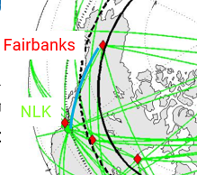
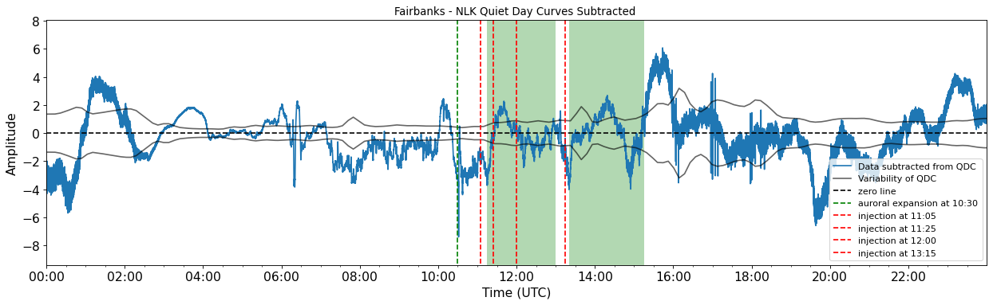
To see the perturbations more clearly, we subtract off the QDC
(dB)
The arrows are perturbations pointed out near the time of pulsating aurora event
Perturbation = deviation from the QDC that is outside of the normal variability
The zero line and the variability of the QDC serve to help guide your eye to see what is an event

Slide 22
Talk Outline
Pulsating aurora
Night of the LAMP launch
Overview of the AARDDVARK system
Plan of how I’m using ARRDDVARK
Paths will intersect pulsating aurora are
Quiet day curve fit
VLF Amplitude data with examples of perturbations
Movie of perturbations per path
Future work - Area estimation

